Slide 1





ETL 2 :
The cloud infrastructure
Laura Belmond - Solution Engineer

Slide 2
TABLE
OF CONTENT
Introduction
The cloud providers
Examples of real company pipeline
Team work

Slide 3

Final Evaluation & Deliverables
Groupe project : 5 people = 5 roles. Example :
Chief Information officer (gouvernance focus)
Data visualization (Dashboard Focus)
Data engineer I (pipeline & automation)
Data engineer II (pipeline & automation)
Head of Architect (Architecture design )

Slide 4
Groups
Groupe 1 : Second hand luxury
Groupe 2 : Fragrance
Groupe 3 : Figurines
Groupe 4 : Clothes
Groupe 5 : Cars
Groupe 6 : Organic products
Groupe 7 : Fintech / customer behavior
Groupe 8 : Watches (special wood)

Slide 5
Today Deliverables :
Ingestion Script
Slide about your data pipeline

Slide 6
Yesterday Recap :
Congrats ! You have created a data generator & your snowflake environment with ressources. Now let’s debrief.

Slide 7
What you created :
CREATE WAREHOUSE IF NOT EXISTS INGEST;
CREATE ROLE IF NOT EXISTS INGEST;
GRANT USAGE ON WAREHOUSE INGEST TO ROLE INGEST;
GRANT OPERATE ON WAREHOUSE INGEST TO ROLE INGEST;
CREATE DATABASE IF NOT EXISTS INGEST;
USE DATABASE INGEST;
CREATE SCHEMA IF NOT EXISTS INGEST;
USE SCHEMA INGEST;
GRANT OWNERSHIP ON DATABASE INGEST TO ROLE INGEST;
GRANT OWNERSHIP ON SCHEMA INGEST.INGEST TO ROLE INGEST;
-- Create user (replace YOUR_PASSWORD with a secure password)
CREATE USER INGEST PASSWORD='YOUR_PASSWORD' LOGIN_NAME='INGEST'
MUST_CHANGE_PASSWORD=FALSE, DISABLED=FALSE,
DEFAULT_WAREHOUSE='INGEST', DEFAULT_NAMESPACE='INGEST.INGEST',
DEFAULT_ROLE='INGEST';
GRANT ROLE INGEST TO USER INGEST;

Slide 8
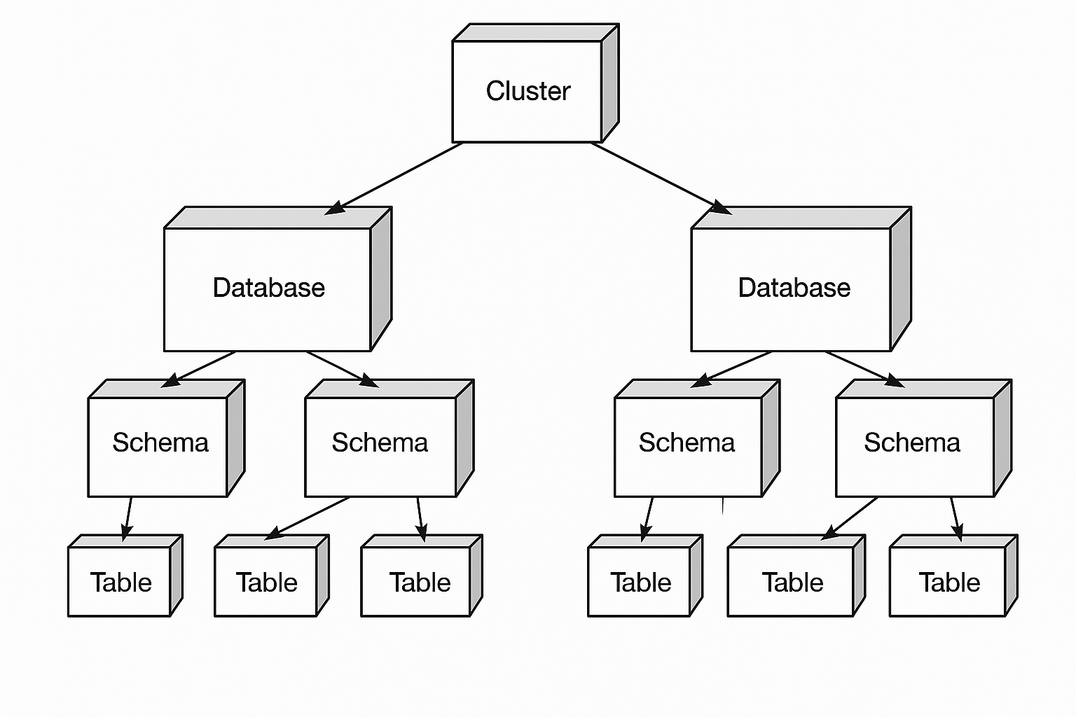
Yesterday Recap :
Sources

Slide 9
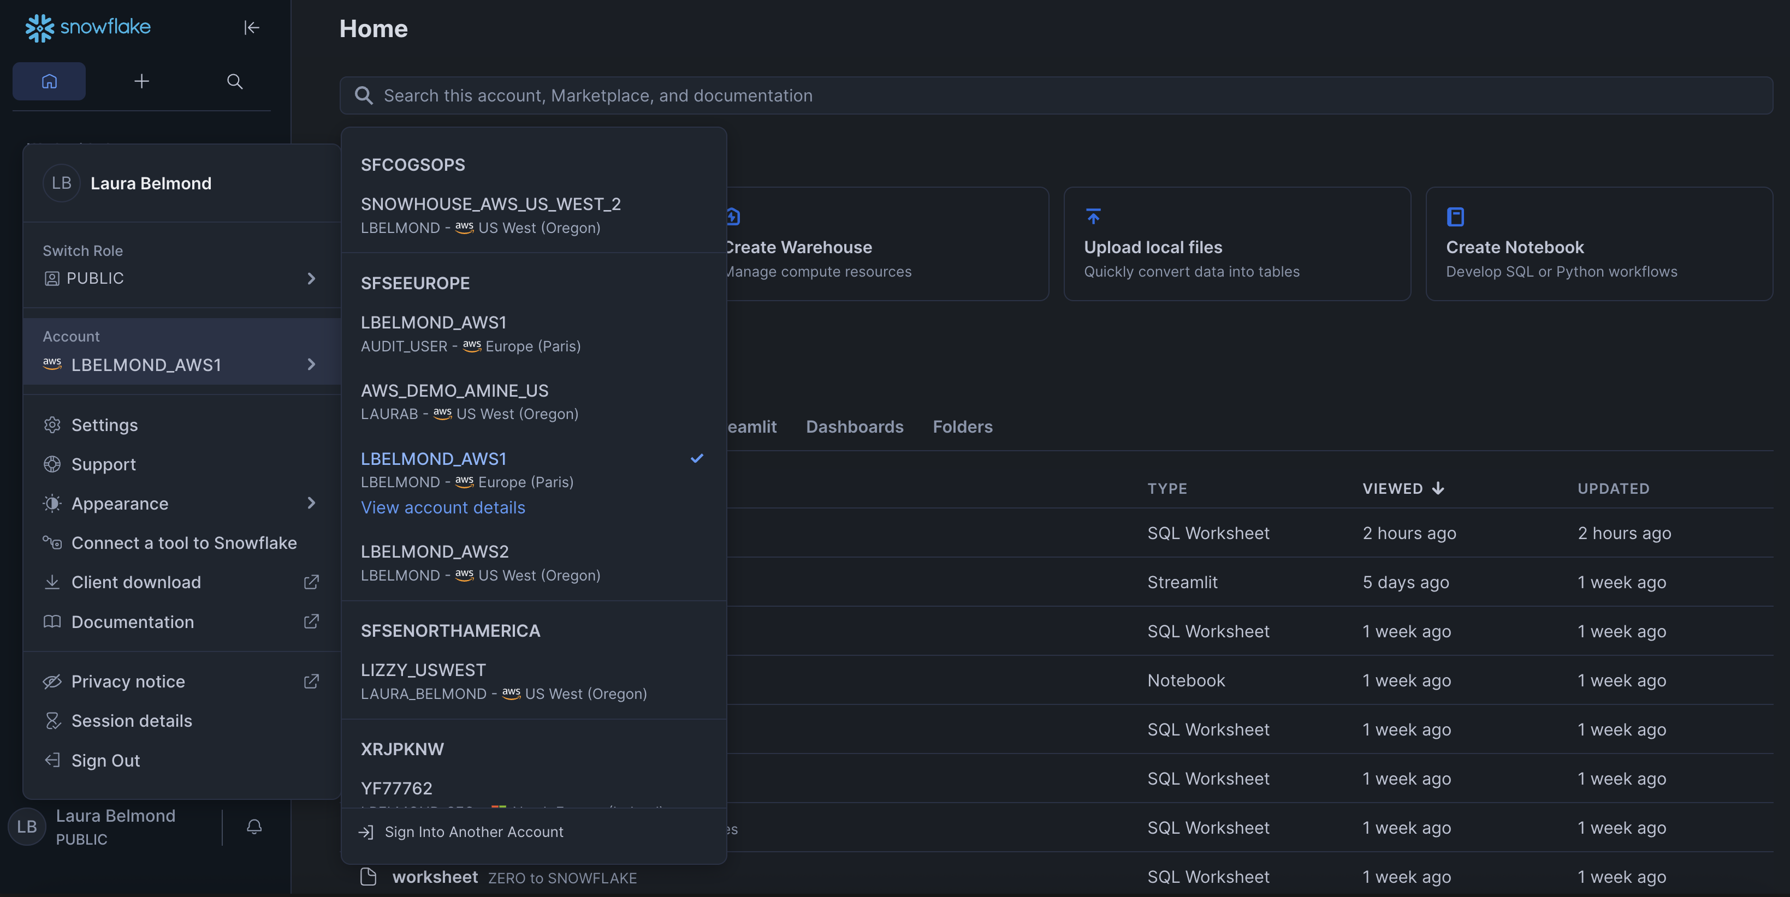
Snowflake : ‘view account details’

Slide 10

Snowflake : exploration of a data warehouse

Slide 11
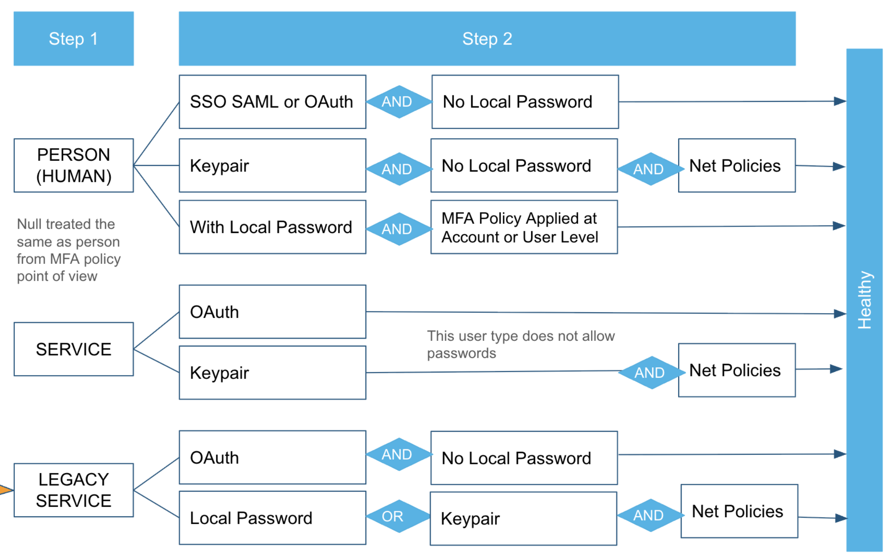
Snowflake : How to access the warehouse

Slide 12
Keypair
Think of your key pair as a special lock and key set:
The Private Key is the Unique Key: This is the physical key that you hold. It's the only tool that can create the correct signature (the "turn of the lock").
The Public Key is the Lock's Unique Pattern: This is the lock you attach to your front door (or the key you give to Snowflake). It defines the exact pattern needed to open it.

Slide 13
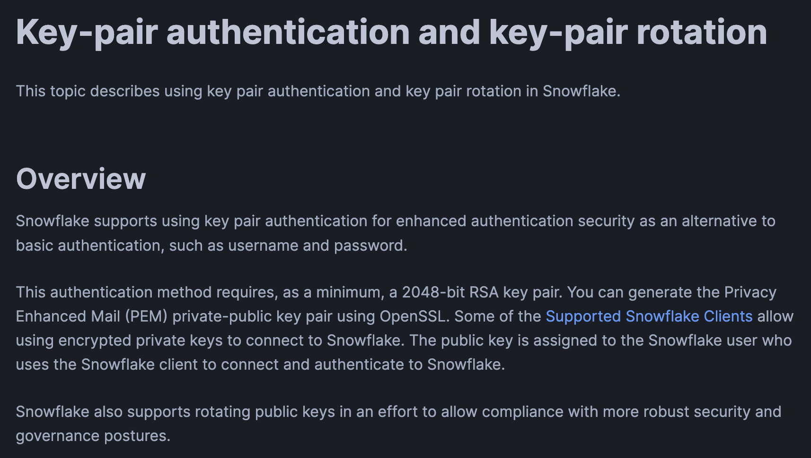
Keypair on snowflake (don’t set up rotation)
https://docs.snowflake.com/en/user-guide/key-pair-auth

Slide 14
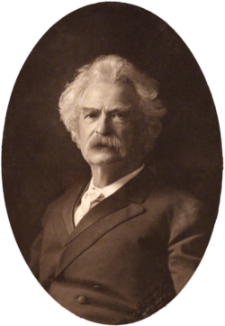
Building a Data Pipeline, how ?
Definition: Cloud computing is the on-demand delivery of IT resources (compute, storage, databases, networking, etc.) over the Internet with pay-as-you-go pricing.
The Key Shift: It represents a strategic shift from CAPEX (Capital Expenditure, fixed cost on hardware) to OPEX (Operational Expenditure, variable cost based on consumption).
Core Benefits: Agility, massive scale, global reach, and cost efficiency.

Slide 15

Building a Data Pipeline, how ?

Slide 16
TABLE
OF CONTENT
Introduction : What is the mood today?
The cloud providers
Examples of real company pipeline
Team work

Slide 17
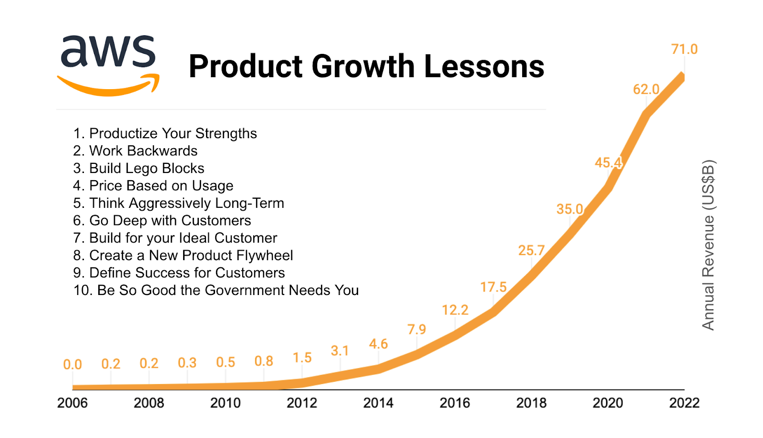
AWS

Slide 18
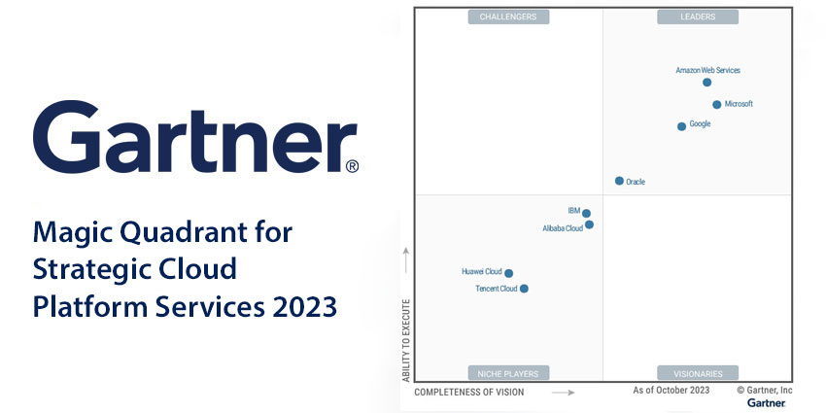

Slide 19
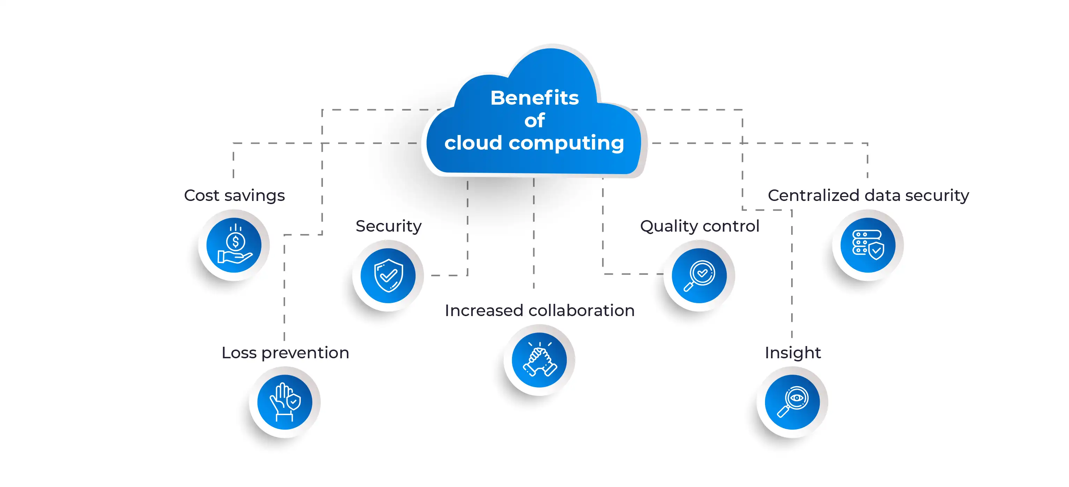

Slide 20
The Shared Responsibility Model:
More Responsibility
IaaS (Infrastructure as a Service):
What you manage: Operating System (OS), applications, data.
What the provider manages: Servers, storage, networking, physical security.
Examples: AWS, Azure, Oracle
PaaS (Platform as a Service): Provides a runtime environment for developing, running, and managing applications.
What you manage: Applications and data only.
What the provider manages: OS, servers, runtime environment, middleware.
Focus: Developers can focus purely on code logic.
Examples: AWS RDS (Managed Databases), SAP Cloud
SaaS (Software as a Service): Provides a complete software solution ready for use.
What you manage: User access and your data.
What the provider manages: Everything else (application, OS, infrastructure, etc.).
Example in Data: Snowflake (Cloud Data Warehouse), Salesforce, Fivetran.
Less Responsibility

Slide 21
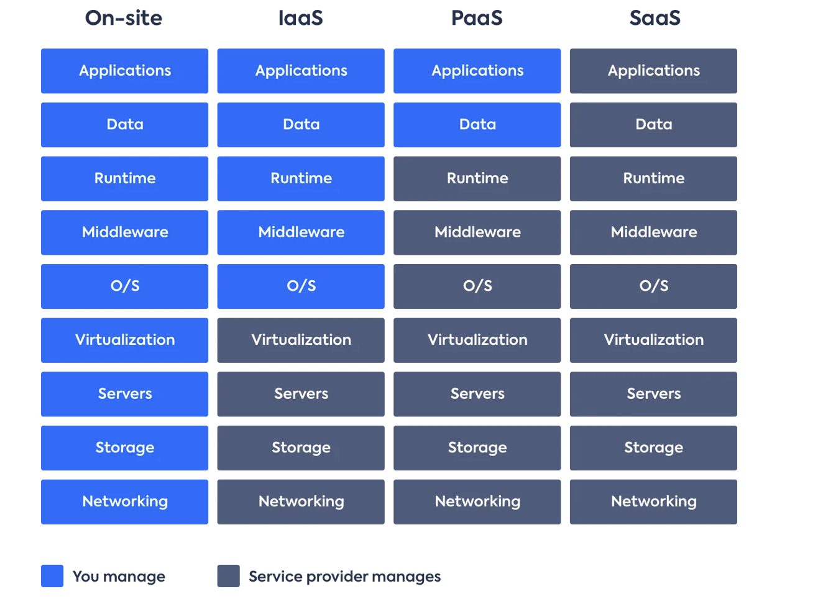

Slide 22
AWS
Market Position: Market Leader, most mature ecosystem, vast array of services.
Key Data Services:
Storage (Data Lake): S3 (Simple Storage Service). Highly durable and scalable.
Data Warehouse: Redshift.
Compute/Serverless: EC2, AWS Lambda.
Orchestration: Managed Apache Airflow (MWAA).

Slide 23
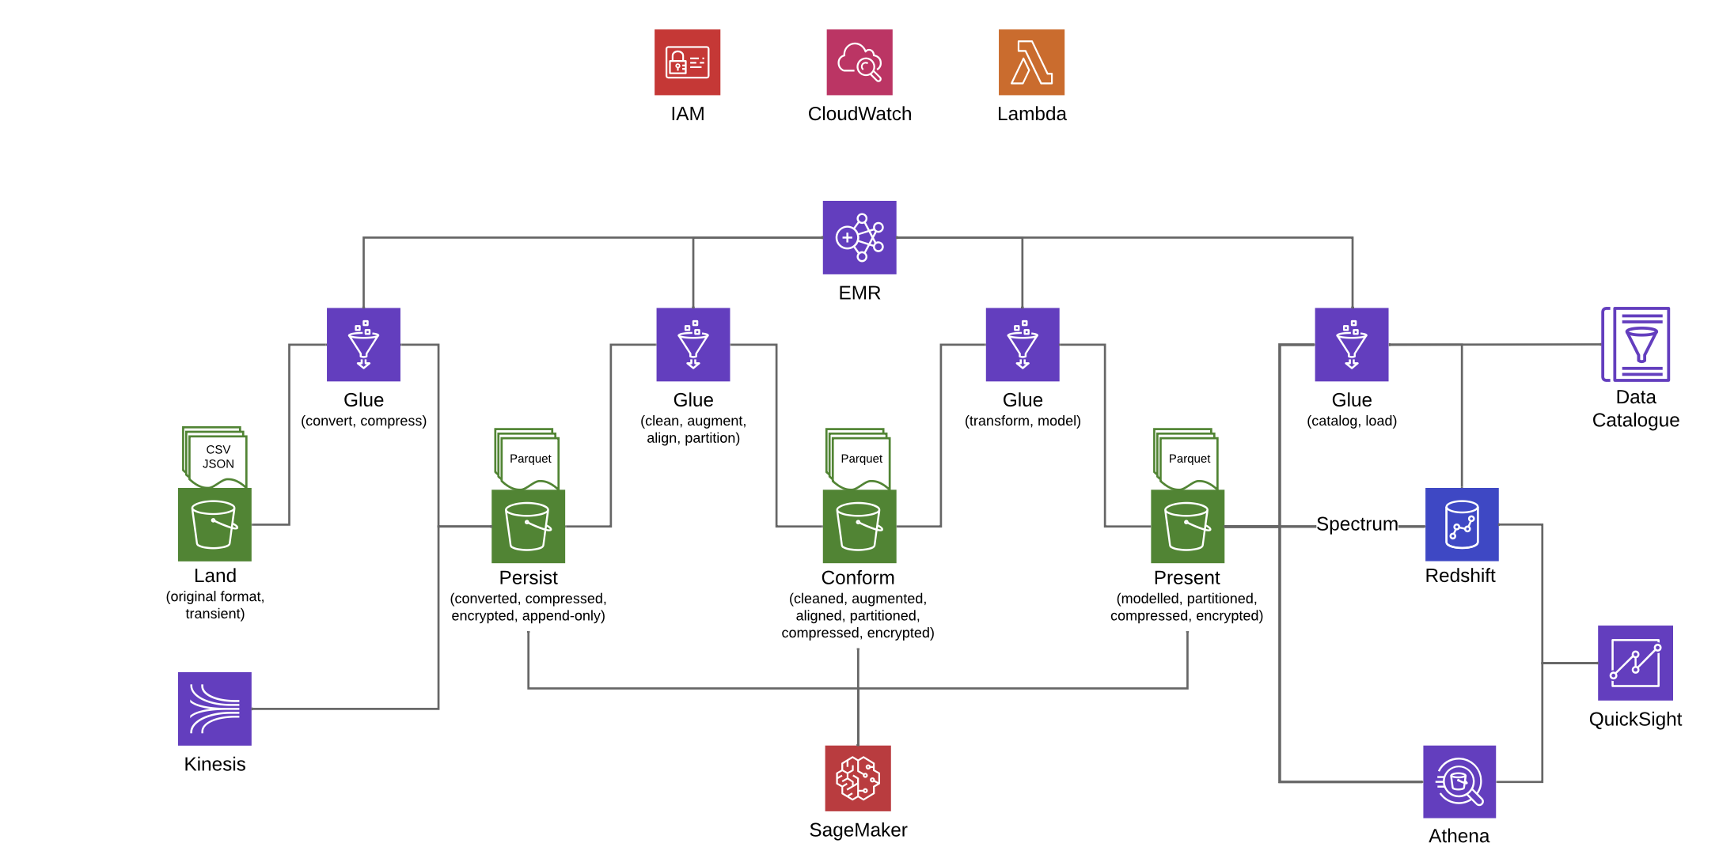
AWS

Slide 24
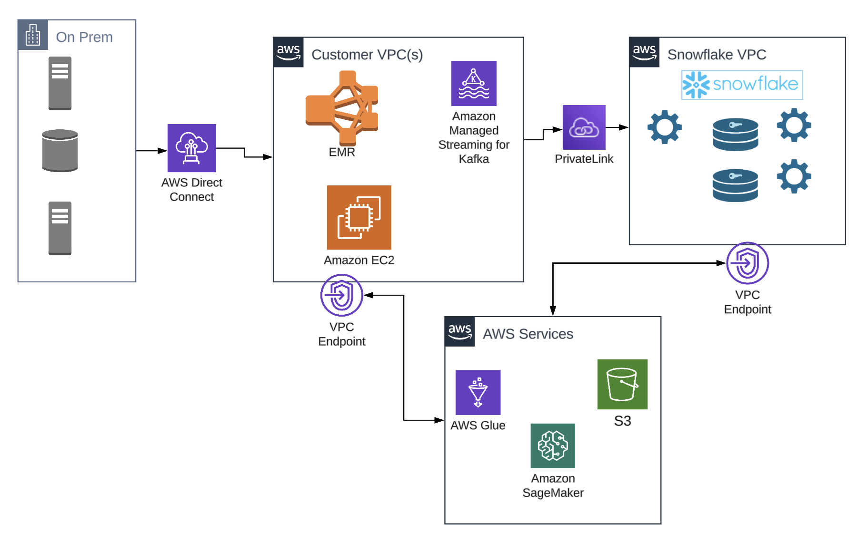
AWS with Snowflake

Slide 25
Azure
Market Position: Strong focus on the Enterprise, excellent integration with existing Microsoft stack.
Key Data Services:
Storage (Data Lake): Azure Blob Storage, Azure Data Lake Storage (ADLS).
Data Warehouse: Fabrics, Azure Synapse Analytics, Azure SQL Database.
Data Integration/Orchestration: Azure Data Factory (ADF).

Slide 26
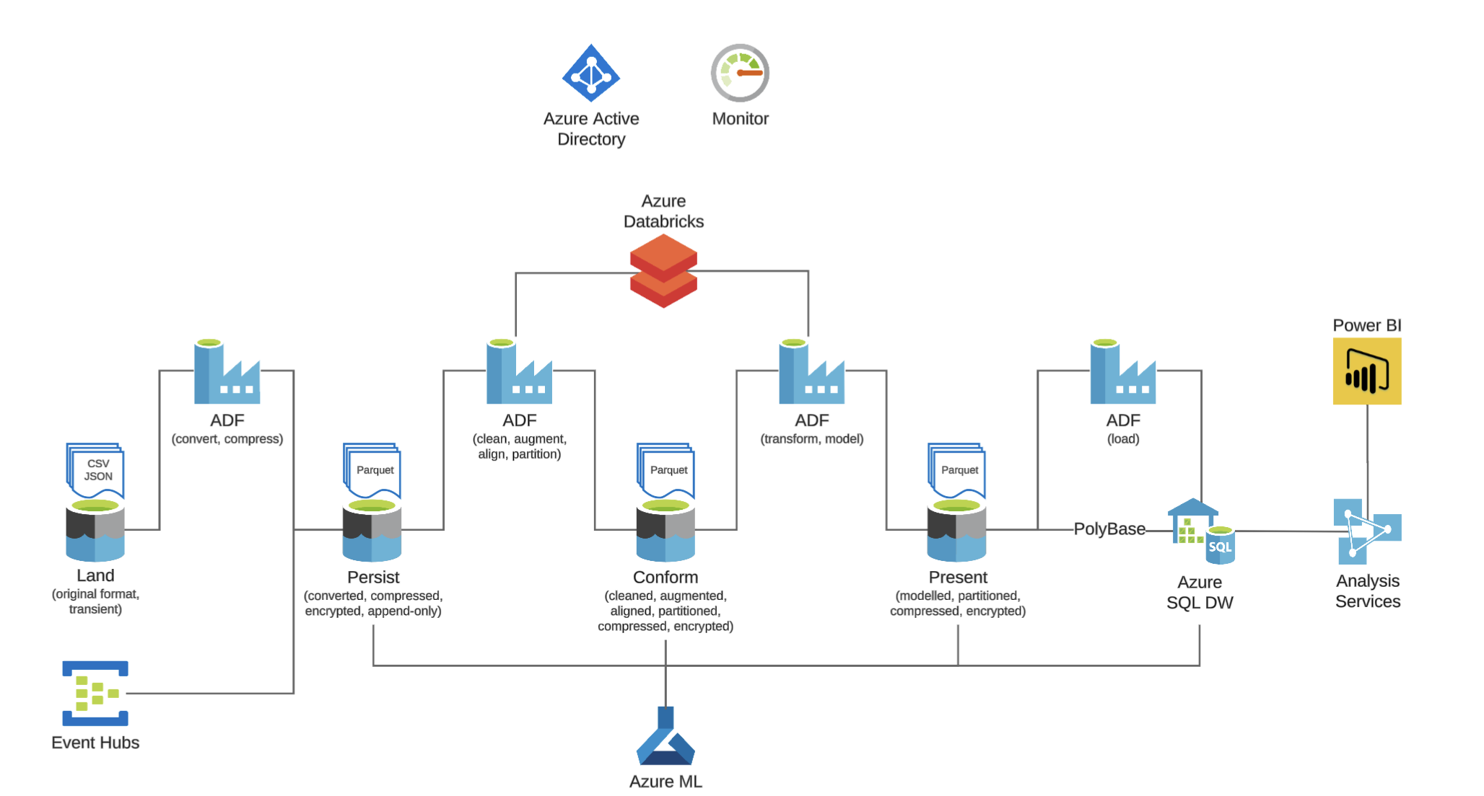
Azure

Slide 27
GCP
Known for its foundation in open-source technologies, strong AI/ML services, and superior internal networking infrastructure.
Key Data Services:
Storage (Data Lake): Google Cloud Storage (GCS).
Data Warehouse: BigQuery ( a fully serverless and highly scalable DWH).
Data Processing: Cloud Dataflow (Apache Beam).
Orchestration: Cloud Composer (Managed Apache Airflow).

Slide 28
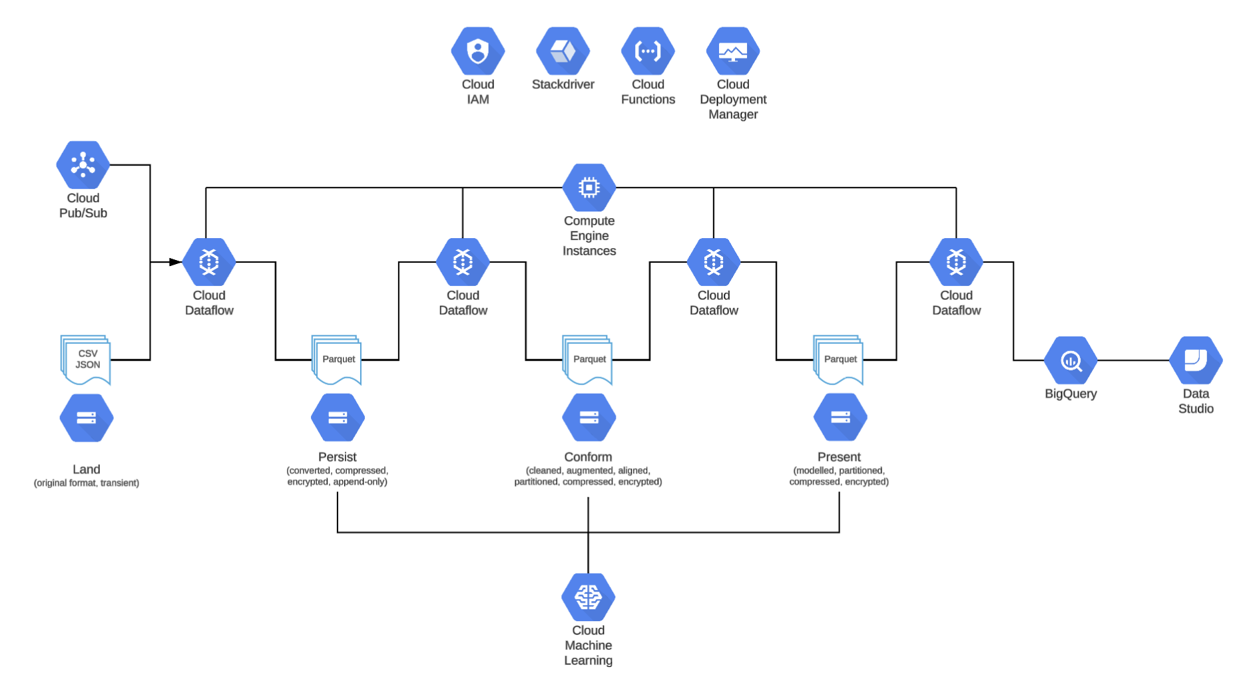
GCP

Slide 29
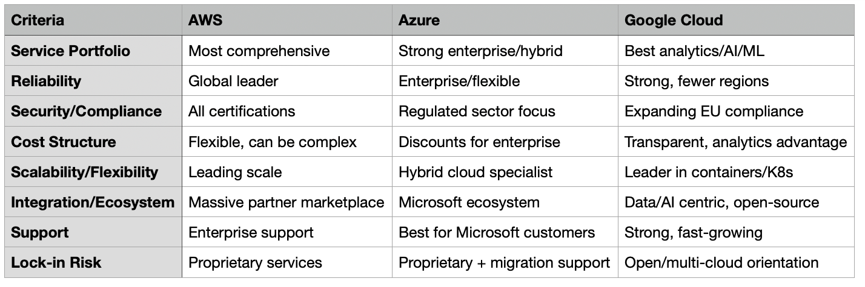
Little comparaison

Slide 30
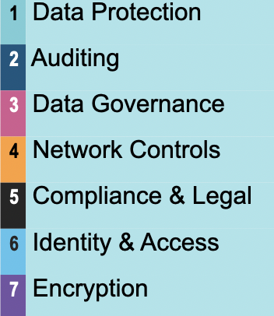
Security aspects

Slide 31







Compliance and Legal

Slide 32
TABLE
OF CONTENT
Introduction : What is the mood today?
The cloud providers
Examples of real company pipeline
Team work

Slide 33
TABLE
OF CONTENT
Introduction : What is the mood today?
The cloud providers
Examples of real company pipeline
Team work
BUT BEFORE

Slide 34
First query challenge
There are 3 queries to solve (without chatGPT). These queries are inspired by my real interviews at
Google, Amazon & Snowflake.
The purpose is to have an approximate answer quite fast & to understand the logic.

Slide 35
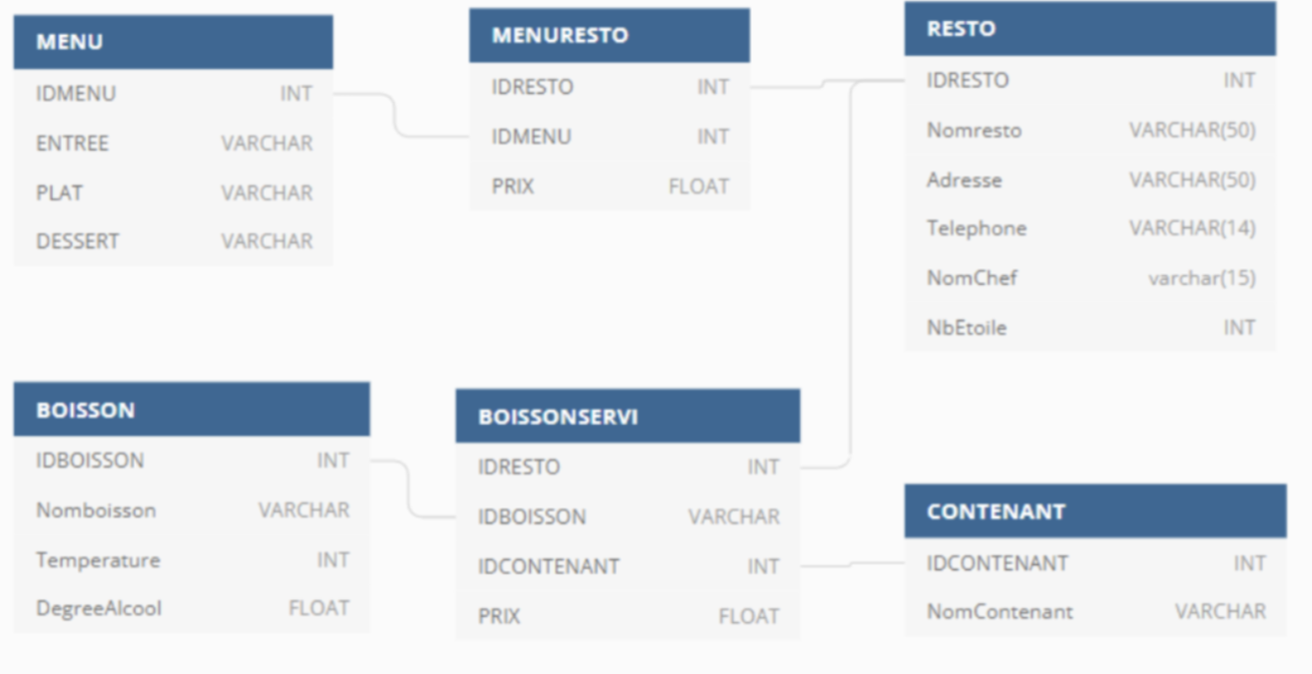
First query challenge
Give the name address and phone number of each restaurant that serve a main course (plat) based on chicken

Slide 36
TABLE
OF CONTENT
Introduction : What is the mood today?
The cloud providers
Examples of real company pipeline
Team work

Slide 37
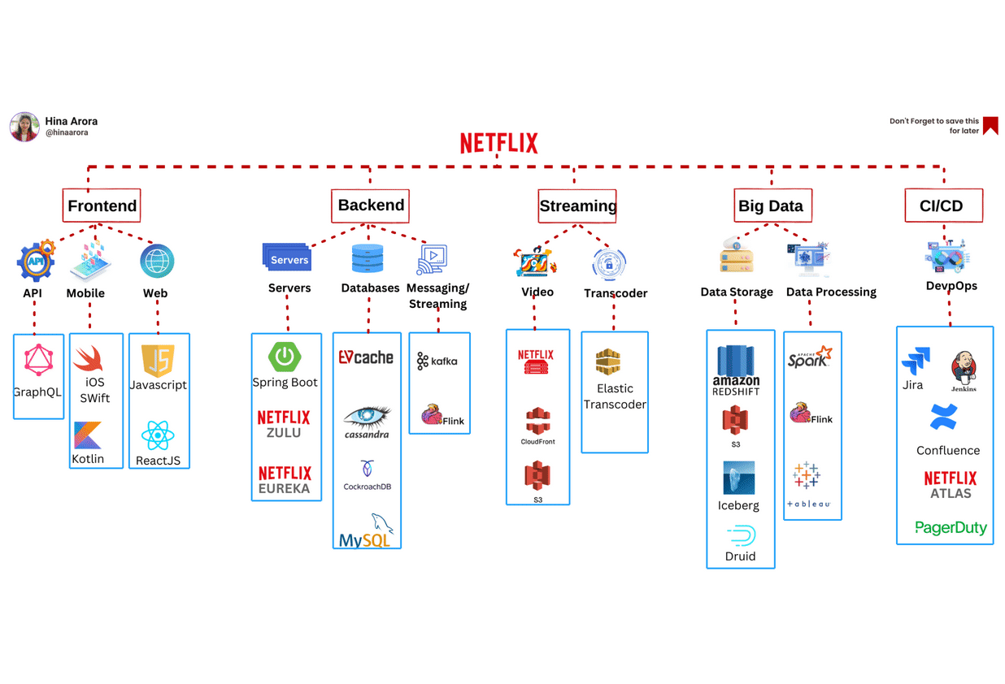
Netflix

Slide 38
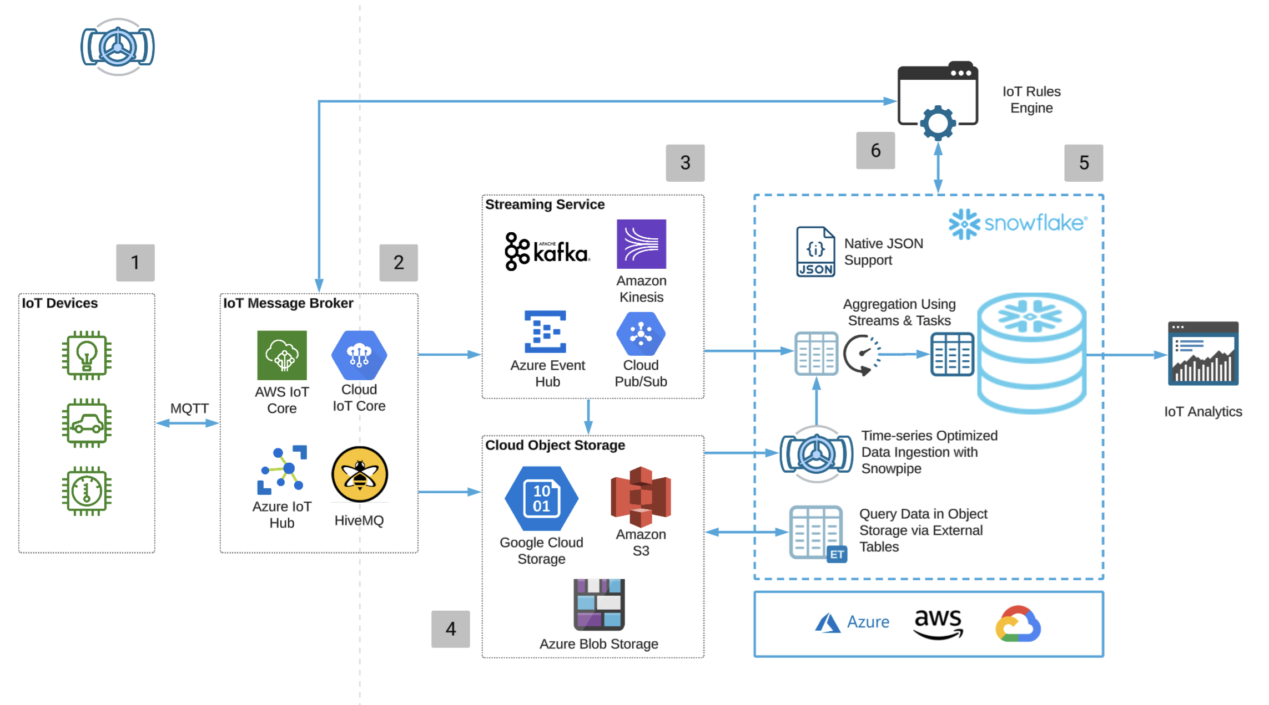
Example for Ferrari (or Manufactures)

Slide 39
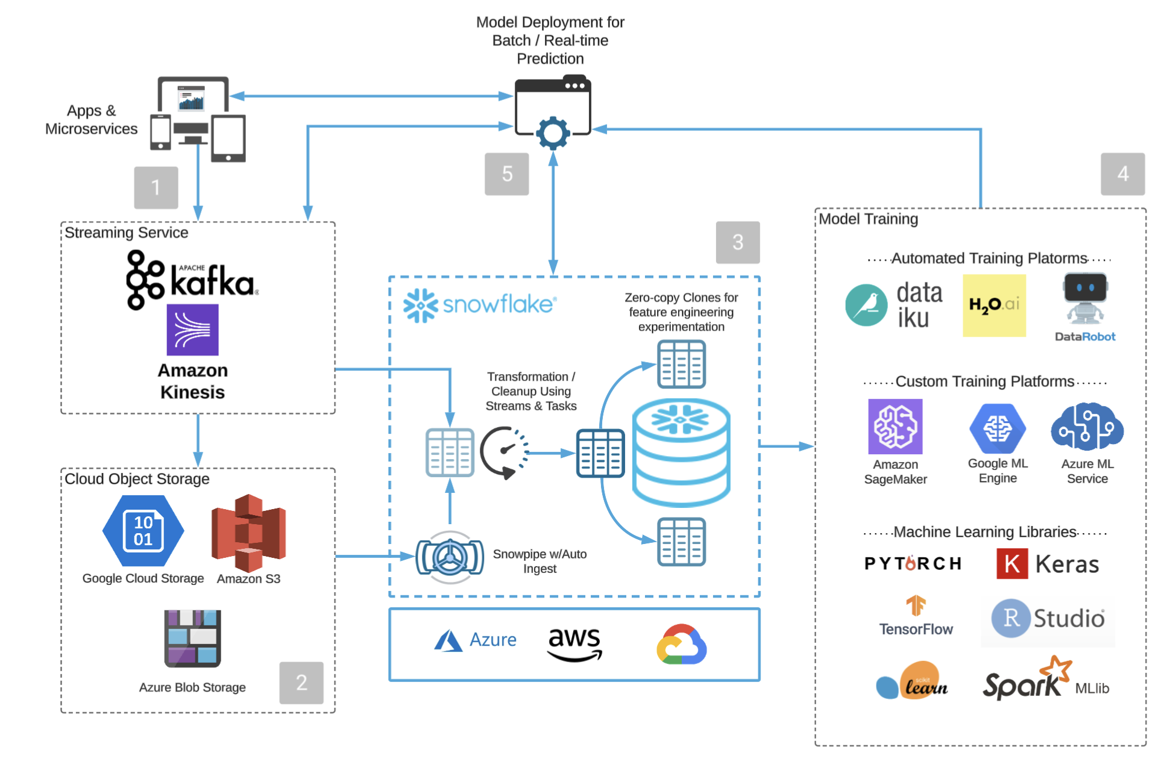
Last exemple : pipeline for a use case.

Slide 40
TABLE
OF CONTENT
Introduction : What is the mood today?
The cloud providers
Examples of real company pipeline
Team work

Slide 41
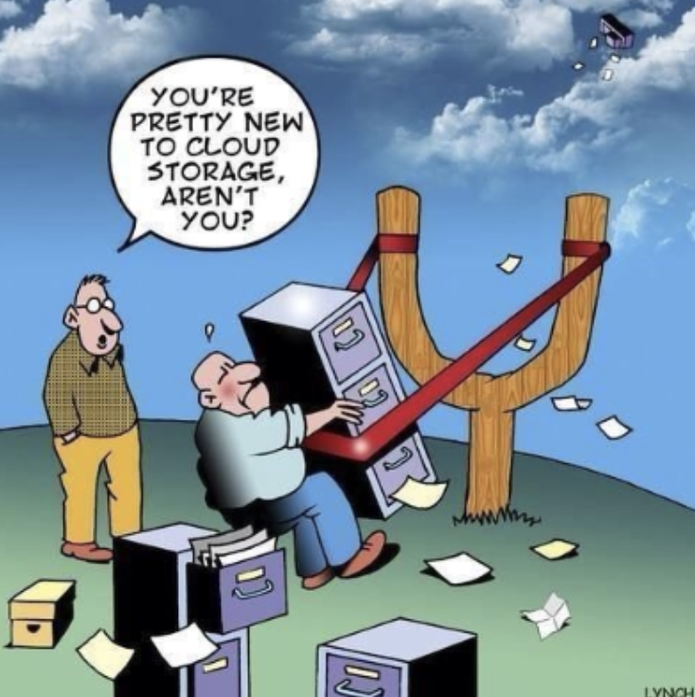
Your Turn
Create a data pipeline for your use case.

